Slide 1


Institute of Technology of Cambodia
Master of Data Science
IT Project Management
Project Planning Phase
Instructed by: M. CHAN Sophal
Present by:
Han Chandeth

Slide 2
Outline
Project scope management plan
Project Scope Statement
Work Break Down Structure
Project Activities Time Planning
Cost Estimation

Slide 3
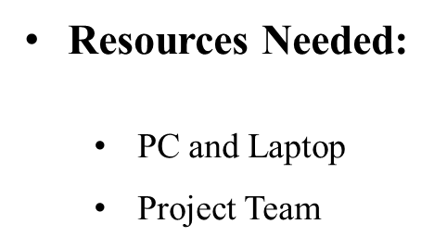
1. Project Scope Management Plan
Project Objectives:
To create a website as a platform for providing and finding translation and interpretation job
Client | Mr. Oudom Kem
Sponsor | Mr. Sophal Chan
Project Manager | Ms. Chandeth Han

Slide 4
2. Project Scope Statement
Project Requirements
1. Create a website platform for translation and interpreting job
2. Clients can provide translation and interpreting job
3. Translators and interpreters can accept and update their work
Project Deliverables
1. budget report
2. project guideline
3. software test
Project Constraint
1. Time bound
2. Project cost

Slide 5
3. Work Breakdown Structure

Slide 6
3. Work Breakdown Structure (Dictionary)

Slide 7
4. Project Timeline

Slide 8
4. Cost Estimation

Slide 9
Thank you!!!

